Slide 1
Backend Development
With Node.JS
Instructor – Satya Priya Arya

Slide 2
UNIT 1
Introduction to Node.js

Slide 3
Frontend v/s Backend v/s Database
The front end is the part of the website users can see and interact with such as the graphical user interface (GUI) and the command line including the design, navigating menus, texts, images, videos, etc. Examples – HTML, CSS, Java-Script, jQuery, React
The backend, on the contrary, is the part of the website users cannot see and interact with. Example – C, C++, Java, Node.JS, C#
The database used to store permanent information Example – SQL Server, MySQL, MongoDB

Slide 4
What is Node.JS
Node.js is an open source server environment
Node.js runs on various platforms (Windows, Linux, Unix, Mac OS X, etc.)
Node.js uses JavaScript on the server

Slide 5
History of Node.js
Before 2009, web browsers used JavaScript.
JS was invented in the 1990 as a scripting language for adding dynamic features to a web page from an HTML file.
On the other hand, Ryan Dahl created a runtime environment for JavaScript to operate outside of web browsers in 2009.
npm, a package manager for the Node.js environment, was released in January 2010.
Current version is 19.4.0 (LTS version is 18.13.0)

Slide 6
Why Node.js – part 1/2
Typical backend application works
Receive Request
Process Request
Send Response
Wait for next request
How Node.JS work
Receive Request
Ready to handle next request
Send response when previous request completed

Slide 7
Why Node.js – part 2/2
Node.js eliminates the waiting, and simply continues with the next request.
Node.js is
single-threaded,
non-blocking,
asynchronous programming

Slide 8
Node.js Architecture – part 1/3
Requests: Depending on the actions that a user needs to perform, the requests to the server can be either blocking (complex) or non-blocking (simple).
Node.js Server: The Node.js server accepts user requests, processes them, and returns results to the users.
Event Queue: The main use of Event Queue is to store the incoming client requests and pass them sequentially to the Event Loop.
Thread Pool: The Thread pool in a Node.js server contains the threads that are available for performing operations required to process requests.
Event Loop: Event Loop receives requests from the Event Queue and sends out the responses to the clients.
External Resources: In order to handle blocking client requests, external resources are used. They can be of any type ( computation, storage, etc).

Slide 9
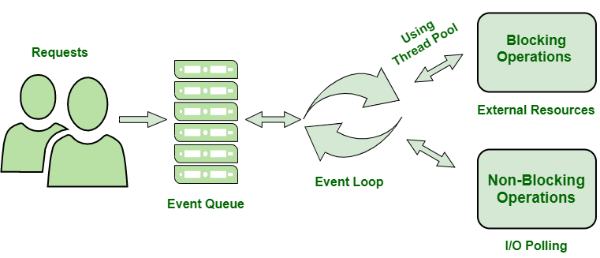
Node.js Architecture – part 2/3

Slide 10
Node.js Architecture – part 3/3
Users send requests (blocking or non-blocking) to the server for performing operations.
The requests enter the Event Queue first at the server-side.
The Event queue passes the requests sequentially to the event loop. The event loop checks the nature of the request (blocking or non-blocking).
Event Loop processes the non-blocking requests which do not require external resources and returns the responses to the corresponding clients
For blocking requests, a single thread is assigned to the process for completing the task by using external resources.
After the completion of the operation, the request is redirected to the Event Loop which delivers the response back to the client.

Slide 11
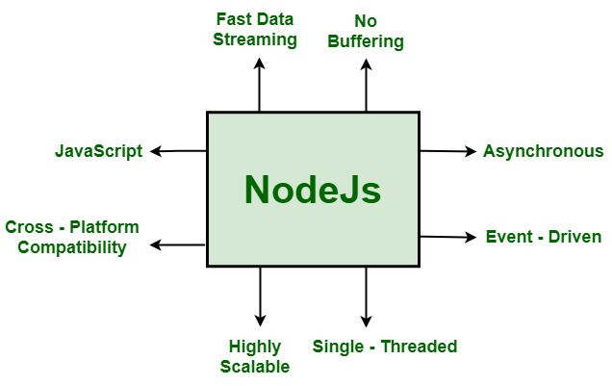
Working and Features

Slide 12
Installation and Setup
Install Node.JS from https://nodejs.org/
Install Visual Studio Code from https://code.visualstudio.com/download

Slide 13
REPL Environment
REPL is a computer environment like a Windows console or Unix/Linux shell where a command is entered and the system responds with an output in an interactive mode. Node.js or Node comes bundled with a REPL environment
Read − Reads user's input, parses the input into JavaScript data-structure, and stores in memory.
Eval − Takes and evaluates the data structure.
Print − Prints the result.
Loop − Loops the above command until the user presses ctrl-c twice.

Slide 14
REPL Environment Samples
$ node > 1 + 2 3
$ node > console.log("Hello World") Hello World
$ node > var x = 0 undefined > do { ... x++; ... console.log("x: " + x); ... } while ( x < 5 ); x: 1 x: 2 x: 3 x: 4 x: 5 undefined >

Slide 15
REPL Commands
ctrl + c − terminate the current command.
ctrl + c twice − terminate the Node REPL.
ctrl + d − terminate the Node REPL.
Up/Down Keys − see command history and modify previous commands.
tab Keys − list of current commands.
.help − list of all commands.
.break − exit from multiline expression.
.clear − exit from multiline expression.
.save filename − save the current Node REPL session to a file.
.load filename − load file content in current Node REPL session.

Slide 16
Components of Node.js
Node contains many components to develop, test and deploy applications. Main components are
Node CLI
NPM
Package.json
Modules
Third party modules (example mongodb)
Core modules (example update)
Development tools and framework

Slide 17
UNIT 2
Node.js Modules

Slide 18
Modules
Modules is same as libraries.
functionality you want to include in your application.
Module in Node.js is a simple or complex functionality organized in single or multiple JavaScript files which can be reused throughout the Node.js application
Few build-in modules are fs, http, net, os, path, querystring, stream, url, util
We can create our own modules too.

Slide 19
First Program
var http = require('http'); http.createServer(function (req, res) { res.writeHead(200, {'Content-Type': 'text/html'}); res.end('Hello World!'); }).listen(8080);
Save file as hello.js
Run “node hello.js” from terminal
Open browser and open http://localhost:8080/
Modify res.end('Hello World!'); to res.write(req.url) and try with http://localhost:8080/Hello/

Slide 20
Module Exports
The module.exports in Node.js is used to export any literal, function or object as a module. It is used to include JavaScript file into node.js applications.
module.exports = literal | function | object Here the assigned value (literal | function | object) is directly exposed as a module and can be used directly.
module.exports.variable = literal | function | object Here the assigned value (literal | function | object) is indirectly exposed as a module and can be consumed using the variable.

Slide 21
Exports Literals
module.exports = “Hello world example"; save in app.js
const demo = require("./app"); console.log(demo); save in index.js

Slide 22
Exports Objects
module.exports = {
name: ‘Learn node js',
website: 'https://nodejs.org'
}
const demo = require('./app');
console.log(demo.name);
console.log(demo.website);

Slide 23
Exports Functions
module.exports = function (a, b) {
console.log(a + b);
}
const sum = require('./app');
sum(2, 5);

Slide 24
Exports Functions as Class
module.exports = function () {
this.name = ‘Hello Demo';
this.website = 'https://nodjs.org';
this.info = () => {
console.log(`Company name - ${this.name}`);
console.log(`Website - ${this.website}`);
}
}
const Company = require('./app');
const firstCompany = new Company();
firstCompany.info();

Slide 25
Exports Multiple Functions
Store many related functions in one js file
function add(x, y) { return x + y; }
function subtract…
function mutliply …
function divide…
…
Module.exports = { add, subtract, multiply, … }
Use whichever is required
const f = require('./func');
const result = f.add(10, 5);

Slide 26
Loading Module from separate folder
Navigate to parent or child folder and locate location of module.
Examples:
const index = require('./models/folder/path/index.js');
const module = require('../../controllers/index.js');

Slide 27
File System Module
File System module allows you to work with the file system on your computer.
var fs = require('fs');
Common use for the File System module:
Create
Read
Update
Rename
Delete

Slide 28
Synchronous v/s Asynchronous
Synchronous also called blocking functions It waits for operation to complete, and only after that, it executes the next operation
Asynchronous also called non-blocking functions It never waits for each operation to complete, rather it executes all operations in the first go itself
Most asynchronous methods has corresponding synchronous method and suffixed as “Sync”
Example – readFile vs readFileSync

Slide 29
Read
var fs = require("fs");
// Asynchronous read
fs.readFile('input.txt', function (err, data) {
if (err) {
return console.error(err);
}
console.log("Asynchronous read: " + data.toString());
});
// Synchronous read
var data = fs.readFileSync('input.txt');
console.log("Synchronous read: " + data.toString());
Observe err if file doesn’t exist

Slide 30
Create, Update, Append
//If the file does not exist, the file will be created
fs.appendFile('mynewfile1.txt', 'Hello content!', function (err) { if (err) throw err; console.log('Saved!'); });
//If the file does not exist, an empty file is created
fs.open('mynewfile2.txt', 'w', function (err, file) { if (err) throw err; console.log('Saved!'); });
//If the file does not exist, a new file, with text, will be created
fs.writeFile('mynewfile3.txt', 'Hello content!', function (err) { if (err) throw err; console.log('Saved!'); });

Slide 31
Other useful operations
exists()
existsSync()
truncate()
renameSync()
unlink()

Slide 32
Assignment# 1
http module – createServer, req, res
fs module – create file, read file, check if file exits
Basic html file

Slide 33
Assignment Objective
Create a node application which accept a file name in url. Example – localhost:8080/file.txt
If file exists in current folder then read file and display content in browser followed by text “File already exists and contents are:”.
If file doesn’t exists then create file into current folder and display content in browser “File does not exists but created successfully.”. File contents should be “File created on Date”
Modify application to read html files and display formatted html into browser.
Modify application to append file extension like and application should add html extension automatically.
Modify application to create separate user defined java-script functions like Exists, ReadFile, CreateFile. All functions should be Sync.

Slide 34
Assignment Solution
var http = require('http');
var fs = require('fs');
function Exists(file){
//return true/false
const existance = fs.existsSync(file);
return existance;
}
function ReadFile(file){
//return content of file or error message
return fs.readFileSync(file);
}
function CreateFile(file){
//create file in data folder and return message
fs.writeFileSync(file, 'File created on ' + Date());
}
http.createServer(function (req, res) {
res.writeHead(200, {'Content-type': 'text/html'});
var fileName = req.url.replace('/', '') + '.html';
if (Exists(fileName)){
res.write('File already exists and contents are:')
var content = ReadFile(fileName);
res.write(content);
}
else{
res.write('File does not exists but created successfully.')
var output = CreateFile(fileName);
}
res.end();
}).listen(8080);

Slide 35
Assignment Solution
var http = require('http');
var fs = require('fs');
function Exists(file){
//return true/false
const existance = fs.existsSync(file);
return existance;
}
function ReadFile(file){
//return content of file or error message
return fs.readFileSync(file);
}
function CreateFile(file){
//create file in data folder and return message
fs.writeFileSync(file, 'File created on ' + Date());
}
http.createServer(function (req, res) {
res.writeHead(200, {'Content-type': 'text/html'});
var fileName = req.url.replace('/', '') + '.html';
if (Exists(fileName)){
res.write('File already exists and contents are:')
var content = ReadFile(fileName);
res.write(content);
}
else{
res.write('File does not exists but created successfully.')
var output = CreateFile(fileName);
}
res.end();
}).listen(8080);

Slide 36
Events and Event Emitters
Node.js is perfect for event-driven applications.
Every action on a computer is an event. Like when a connection is made or a file is opened.
Node.JS provides way to create and handle custom events.
The EventEmitter class can be used to create and handle custom events module.
2 steps:
Listening events: Before emits any event, it must register functions(callbacks) to listen to the events.
Removing Listener: The eventEmitter.removeListener() takes two argument event and listener, and removes that listener from the listeners array that is subscribed to that event. While eventEmitter.removeAllListeners() removes all the listener from the array which are subscribed to the mentioned event.

Slide 37
Handling Events
Emitting events example
// Importing events
var EventEmitter = require('events');
// Initializing event emitter instances
var eventEmitter = new EventEmitter();
// Registering to myEvent
eventEmitter.on('myEvent', (msg) => {
console.log(msg);
});
// Triggering myEvent
eventEmitter.emit('myEvent', "First event");

Slide 38
Handling Events
// Initializing event emitter instances
var eventEmitter = new EventEmitter();
var geek1= (msg) => {
console.log("Message from geek1: " + msg);
};
var geek2 = (msg) => {
console.log("Message from geek2: " + msg);
};
// Registering geek1 and geek2
eventEmitter.on('myEvent', geek1);
eventEmitter.on('myEvent', geek2);
// Removing listener geek1 that was
// registered previously
eventEmitter.removeListener('myEvent', geek1);
// Triggering myEvent
eventEmitter.emit('myEvent', "Event occurred");
// Removing all the listeners to myEvent
eventEmitter.removeAllListeners('myEvent');
// Triggering myEvent
eventEmitter.emit('myEvent', "Event occurred");

Slide 39
In-built modules Operating System
The os module provides information about the computer operating system on which node running.
var os = require('os');
// return the cpu architecture
console.log("CPU architecture: " + os.arch());
// It returns the amount of free system memory in bytes
console.log("Free memory: " + os.freemem());
// It return total amount of system memory in bytes
console.log("Total memory: " + os.totalmem());
// It returns the list of network interfaces
console.log('List of network Interfaces: ' + os.networkInterfaces());
// It returns the operating systems default directory for temp files.
console.log('OS default directory for temp files : ' + os.tmpdir ());

Slide 40
os module common methods
arch()Returns the operating system CPU architecture
cpus()Returns an array containing information about the computer's CPUs
freemem()Returns the number of free memory of the system
hostname()Returns the hostname of the operating system
loadavg()Returns an array containing the load averages, (1, 5, and 15 minutes)
platform()Returns information about the operating system's platform
tmpdir()Returns the operating system's default directory for temporary files
totalmem()Returns the number of total memory of the system
type()Returns the name of the operating system
uptime()Returns the uptime of the operating system, in seconds
userInfo()Returns information about the current user

Slide 41
Assignment# 2
os module

Slide 42
Assignment Objective
Write application which display following information on browser
CPU model
CPU architecture
OS platform
Hint
We can’t print object in browser directly. Instead use console to print an object and then grab element to print desired detail

Slide 43
Assignment Solution
var http = require('http');
var os = require('os');
http.createServer(function (req, res) {
res.writeHead(200, {'Content-type': 'text/html'});
const cpus = os.cpus();
res.write('Model is: ' + cpus[0].model);
res.write('<br/>');
res.write('Architecture is: ' + os.arch());
res.write('<br/>');
res.write('OS Platform is: ' + os.platform());
res.end();
}).listen(8080);

Slide 44
Assignment Solution
var http = require('http');
var os = require('os');
http.createServer(function (req, res) {
res.writeHead(200, {'Content-type': 'text/html'});
const cpus = os.cpus();
res.write('Model is: ' + cpus[0].model);
res.write('<br/>');
res.write('Architecture is: ' + os.arch());
res.write('<br/>');
res.write('OS Platform is: ' + os.platform());
res.end();
}).listen(8080);

Slide 45
UNIT 3
Node.js Buffers

Slide 46
Buffers
Pure JavaScript is great with strings, but it does not handle binary data very well.
The buffers module provides a way of handling streams of binary data.
The Buffer object is a global object in Node.js, and it is not necessary to import it using the require keyword.
Buffer refers to the particular memory location in memory
Buffer and array have some similarities, but the difference is array can be any type, and it can be resizable. Buffers only deal with binary data, and it can not be resizable.

Slide 47
Create Buffer
Specified length of octent var buf = new Buffer(10);
From a given array var buf = new Buffer([10, 20, 30, 40, 50]);
From a string with/without encoding var buf = new Buffer("Simply Easy Learning", "utf-8");

Slide 48
Write Buffer
Syntax buf.write(string[, offset][, length][, encoding]) This method returns the number of octets written
Example
buf = new Buffer(256);
len = buf.write("Simply Easy Learning");
console.log("Octets written : "+ len);
Output Octets written : 20

Slide 49
Reading from Buffer
Syntax buf.toString([encoding][, start][, end]) This method decodes and returns a string from buffer data encoded using the specified character set encoding
Example
buf = new Buffer(26); for (var i = 0 ; i < 26 ; i++) { buf[i] = i + 97; }
Output console.log( buf.toString('ascii')); //abcdefghijklmnopqrstuvwxyz console.log( buf.toString('ascii',0,5)); // abcde console.log( buf.toString('utf8',0,5)); // abcde

Slide 50
Concatenate Buffers
Syntax Buffer.concat(list[, totalLength]) This method returns a Buffer instance.
Example
var buffer1 = new Buffer('TutorialsPoint '); var buffer2 = new Buffer('Simply Easy Learning'); var buffer3 = Buffer.concat([buffer1,buffer2]); console.log("buffer3 content: " + buffer3.toString());
Output buffer3 content: TutorialsPoint Simply Easy Learning

Slide 51
Compare Buffers
Syntax buf.compare(otherBuffer); Returns a number indicating whether it comes before or after or is the same as the otherBuffer in sort order.
Example
var buffer1 = new Buffer('ABC'); var buffer2 = new Buffer('ABCD'); var result = buffer1.compare(buffer2); if(result < 0) { console.log(buffer1 +" comes before " + buffer2); } else if(result === 0) { console.log(buffer1 +" is same as " + buffer2); } else { console.log(buffer1 +" comes after " + buffer2); }
Output ABC comes before ABCD

Slide 52
Copy Buffer
Syntax buf.copy(targetBuffer[, targetStart][, sourceStart][, sourceEnd]) No return value
Example
var buffer1 = new Buffer('ABC'); //copy a buffer var buffer2 = new Buffer(3); buffer1.copy(buffer2); console.log("buffer2 content: " + buffer2.toString());
Output buffer2 content: ABC

Slide 53
Slice Buffer
Syntax buf.slice([start][, end]) Returns a new buffer which references the same memory as the old one, but offset and cropped by the start (defaults to 0) and end (defaults to buffer.length) indexes
Example
var buffer1 = new Buffer('TutorialsPoint'); //slicing a buffer var buffer2 = buffer1.slice(0,9); console.log("buffer2 content: " + buffer2.toString());
Output buffer2 content: Tutorials

Slide 54
Stream Module
Streams are one of the Node’s best module.
Streams are collections of data — just like arrays or strings.
The difference is that streams might not be available all at once, and they don’t have to fit in memory.
This makes streams really powerful when working with large amounts of data, or data that’s coming from an external source one chunk at a time.
However, streams are not only about working with big data.
Example OTT platform, YouTube.
We can read data from a source or write data to a destination in continuous way.

Slide 55
Stream types
Readable − Stream which is used for read operation.
Writable − Stream which is used for write operation.
Duplex − Stream which can be used for both read and write operation.
Transform − A type of duplex stream where the output is computed based on input.

Slide 56
Stream Events
data − This event is fired when there is data is available to read.
end − This event is fired when there is no more data to read.
error − This event is fired when there is any error receiving or writing data.
finish − This event is fired when all the data has been flushed to underlying system.

Slide 57
Reading from a stream
var fs = require("fs"); var data = ''; // Create a readable stream var readerStream = fs.createReadStream('input.txt'); readerStream.setEncoding('UTF8'); // Handle stream events --> data, end, and error readerStream.on('data', function(chunk) { data += chunk; }); readerStream.on('end',function() { console.log(data); }); readerStream.on('error', function(err) { console.log(err.stack); });

Slide 58
Reading from a stream
var fs = require("fs"); var data = ''; // Create a readable stream var readerStream = fs.createReadStream('input.txt'); readerStream.setEncoding('UTF8'); // Handle stream events --> data, end, and error readerStream.on('data', function(chunk) { data += chunk; }); readerStream.on('end',function() { console.log(data); }); readerStream.on('error', function(err) { console.log(err.stack); });

Slide 59
Writing to a stream
var fs = require("fs"); var data = 'Simply Easy Learning'; // Create a writable stream var writerStream = fs.createWriteStream('output.txt'); writerStream.write(data,'UTF8'); // Mark the end of file writerStream.end(); // Handle stream events --> finish, and error writerStream.on('finish', function() { console.log("Write completed."); }); writerStream.on('error', function(err) { console.log(err.stack); });

Slide 60
Piping the stream
We provide the output of one stream as the input to another stream
var fs = require("fs"); // Create a readable stream var readerStream = fs.createReadStream('input.txt'); // Create a writable stream var writerStream = fs.createWriteStream('output.txt'); // Pipe the read and write operations // read input.txt and write data to output.txt readerStream.pipe(writerStream);

Slide 61
Chaining the Streams
Connect the output of one stream to another stream and create a chain of multiple stream operations
Example – Read a file -> compress -> Write to another file.
var fs = require("fs"); var zlib = require('zlib'); // Compress the file input.txt to input.txt.gz fs.createReadStream('input.txt') .pipe(zlib.createGzip()) .pipe(fs.createWriteStream('input.txt.gz')); console.log("File Compressed.");

Slide 62
Assignment# 3
Buffers
Streams

Slide 63
Assignment Objective
Read 2 text files “file1.txt” and “file2.txt”. Compare these 2 files using buffer module and display on console “Both files are same” if their contents are same else display “Both files are different”.
Read one text file “file1.txt” and write contents into another file “file2.txt” using stream.

Slide 64
UNIT 4
Node.js RESTAPI

Slide 65
What is API
An application programming interface (API) defines the rules that you must follow to communicate with other software systems.
Mechanisms that enable two software components to communicate with each other using a set of definitions and protocols
Developers expose or create APIs so that other applications can communicate with their applications programmatically.
API is a gateway between clients and resources on the web.
Clients - Clients are users who want to access information from the web. The client can be a person or a software system that uses the API.
Resources - Resources are the information that different applications provide to their clients. Resources can be images, videos, text, numbers, or any type of data.
Example – Stock market API or weather forecast API

Slide 66
What is REST API
Representational State Transfer (REST) API is a software architecture that imposes conditions on how an API should work
APIs that follow the REST architectural style are called REST APIs.
Web services that implement REST architecture are called RESTful web services.

Slide 67
Principles of the REST architectural
Uniform interface - The uniform interface is fundamental to the design of any RESTful webservice. It indicates that the server transfers information in a standard format (typically JSON).
Statelessness - In REST architecture, statelessness refers to a communication method in which the server completes every client request independently of all previous requests.
Layered system - In a layered system architecture, the client can connect to other authorized intermediaries between the client and server, and it will still receive responses from the server.
Cacheability - RESTful web services support caching, which is the process of storing some responses on the client or on an intermediary to improve server response time.
Code on demand - In REST architectural style, servers can temporarily extend or customize client functionality by transferring software programming code to the client.

Slide 68
Benefits of RESTful APIs
Scalability - Systems that implement REST APIs can scale efficiently because REST optimizes client-server interactions.
Flexibility - RESTful web services support total client-server separation.
Independence - REST APIs are independent of the technology used.

Slide 69
How do RESTful APIs work?
The basic function of a RESTful API is the same as browsing the internet. These are the general steps for any REST API call
The client sends a request to the server. The client follows the API documentation to format the request in a way that the server understands.
The server authenticates the client and confirms that the client has the right to make that request.
The server receives the request and processes it internally.
The server returns a response to the client. The response contains information that tells the client whether the request was successful. The response also includes any information that the client requested.

Slide 70
HTTP methods/verbs
Following four HTTP methods are commonly used in REST based architecture.
GET − This is used to provide a read only access to a resource.
POST − This is used to create a new resource.
DELETE − This is used to remove a resource.
PUT − This is used to update a existing resource.

Slide 71
Postman
Postman is an application for API testing.
We don’t need to build UI to validate APIs
We can share APIs across teams.
Download from https://www.postman.com/downloads/
Explain with help of postman
Methods/verbs
Response code
API collections

Slide 72
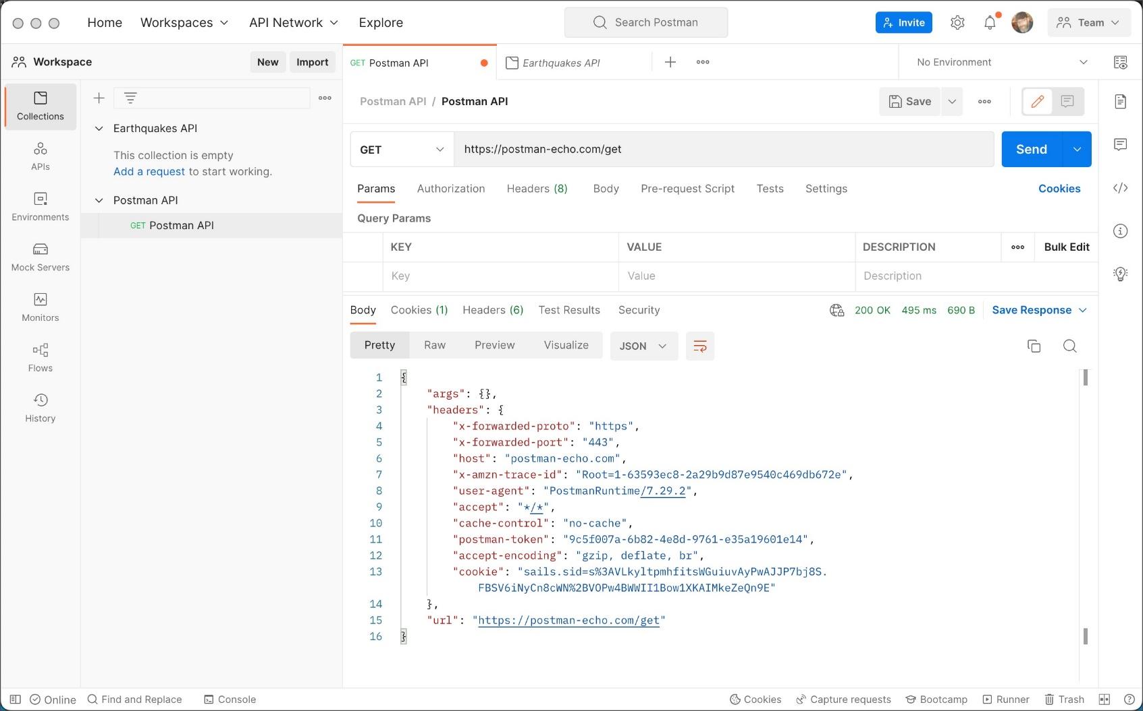
Explain postman

Slide 73
Express module
Express.js is a web framework for Node.js.
It is
Fast
Robust
Asynchronous in nature.
MVC like structure
Ultra fat I/O

Slide 74
Express module
Express is a minimal and flexible Node.js web application framework that provides a robust set of features for web and mobile applications.
Dozens of popular framework are based on express module itself for example NestJS, Kites, LoopBack, etc…
This is not an inbuild module.
We need to install express using “npm install express”

Slide 75
HTTP v/s Express module
HTTP: It is an in-build module which is pre-installed along with NodeJS. It is used to create server and set up connections. Using this connection, data sending and receiving can be done as long as connections use a hypertext transfer protocol.
Express: Express as a whole is known as a framework, not just as a module. It gives you an API, submodules, functions, and methodology and conventions for quickly and easily typing together all the components necessary to put up a modern, functional web server with all the conveniences necessary for that (static asset hosting, templating, handling CSRF, CORS, cookie parsing, POST data handling, and many more functionalities. Install using “npm install express”

Slide 76
HTTP v/s Express module
HTTP example
var http = require('http');
http.createServer(function (req, res) {
res.write('Hello World!');
res.end();
}).listen(3000);
Express example
const express = require('express');
const app = express();
app.get('/', function (req, res) {
res.send("Hello World!, I am server created by expresss");
})
app.listen(3000, function () {
console.log("server started");
})

Slide 77
JSON schema (user.json)
Create a JSON with schema like [
{
"id": 1 ,
"name" : "mahesh",
"password" : "password1",
"profession" : "teacher"
},
{
"id": 2 ,
"name" : "dinesh",
"password" : "password2",
"profession" : "faculty"
},
{
"id": 3 ,
"name" : "mahesh",
"password" : "password1",
"profession" : "teacher"
}
]

Slide 78
Setup express
const express = require('express');
const fs = require('fs');
const cors = require('cors’); //Cross-Origin Resource Sharing
const app = express();
app.use(cors());
// APIs will be created here
app.listen(3000, function () {
console.log("server started");
})

Slide 79
Get Operation
app.get('/listUsers', function (req, res) {
fs.readFile("user.json", 'utf8', function (err, data){
if(err){
console.log("Error " + err);
}
else{
console.log( data );
res.end( data );
}
});
});

Slide 80
Post Operation
app.post('/addUser', function (req, res) {
fs.readFile("user.json", 'utf8', function (err, data) {
if(err){
console.log("Error " + err);
}
else{
data = JSON.parse(data);
data.push(req.body.user); // Save data into user.json
console.log(data);
res.end(JSON.stringify(data));
res.end();
}
})
});

Slide 81
Fix problem of POST
Add following middleware
app.use(express.json());
app.use(express.urlencoded({ extended: false }));
Middleware gets executed after the server receives the request and before send the response.
The objective of express.json() is used to parse the incoming requests with JSON payloads and is based upon the body-parser.
The objective of express.urlencoded() method is to parse the incoming request with urlencoded payloads and is based upon the body-parser.
Middleware can be used to add logging and authentication functionality.
Example – Without middleware we have to write logic in every API to authenticate user.

Slide 82
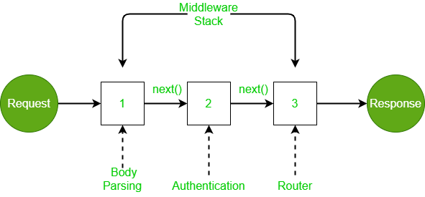
How middleware work

Slide 83
Middleware
Middleware Chaining: Middleware can be chained from one to another, Hence creating a chain of functions that are executed in order.
The last function sends the response back to the browser.
The next() function in the express is responsible for calling the next middleware function if there is one.

Slide 84
Creating own middleware
We can create our own middleware
const myLogger = function (req, res, next) {
console.log('LOGGED')
next()
}
module.exports = myLogger
Save above middleware in a file
Use this file into your nodeJS application
Use middleware using app.use(myLogger);

Slide 85
Detail Operation
app.get('/:id', function (req, res) {
fs.readFile("user.json", 'utf8', function (err, data){
if(err){
console.log("Error " + err);
}
else{
var users = JSON.parse( data );
var user = users[req.params.id]
console.log( user );
res.end( JSON.stringify(user));
}
});
});

Slide 86
Delete Operation
app.delete('/deleteUser/:id', function (req, res) {
fs.readFile("user.json", 'utf8', function (err, data) {
if(err){
console.log("Error " + err);
}
else{
data = JSON.parse(data);
data.splice(req.params.id, 1); // Save data into user.json
console.log(data);
res.end(JSON.stringify(data));
res.end();
}
});
})

Slide 87
Correct way of route
app.get(‘/user’, …)
app.post(‘/user’, …)
app.get(‘/user/:id’, …)
app.delete(‘/user/:id, …)

Slide 88
Routing
Routing defines the way in which the client requests are handled by the application endpoints.
In another way how an application responds to a client request to a particular endpoint, which is a URI (or path) and a specific HTTP request method (GET, POST, and so on).
Each route can have one or more handler functions, which are executed when the route is matched.

Slide 89
Routing
Route definition takes the following structure:
app.METHOD(PATH, HANDLER)
app is an instance of express.
METHOD is an HTTP request method, in lowercase.
PATH is a path on the server.
HANDLER is the function executed when the route is matched. (also called callback functions)

Slide 90
Routing
Route methods –
A route method is derived from one of the HTTP methods, and is attached to an instance of the express class (app);
Route paths
Route paths, in combination with a request method, define the endpoints at which requests can be made. Route paths can be strings, string patterns, or regular expressions. Example app.get('/ab*cd’, …)

Slide 91
Routing
Route parameters
Route parameters are named URL segments that are used to capture the values specified at their position in the URL.
Example
app.get('/users/:userId/books/:bookId', (req, res) => {
res.send(req.params)
})
userId and bookId are parameters and can be replaced anything.
This is a valid route for this example
http://localhost:3000/users/34/books/8989
We can grab route parameters using “req.params”.
Above example will return following output with “req.params”
{ "userId": "34", "bookId": "8989" }
Another example is – “/flights/:from-:to” – Discuss this.

Slide 92
We can handle routing in 2 ways
Without using framework
Using express framework

Slide 93
Routing Without Framework
http.createServer(function (req, res) { var url = req.url; if(url ==='/about') { res.write(' Welcome to about us page'); res.end(); } else if(url ==='/contact') { res.write(' Welcome to contact us page'); res.end(); } else { res.write('Hello World!'); res.end(); } }).listen(3000, function() { console.log("server start at port 3000"); });

Slide 94
Routing With Framework
Use get, post, delete methods with URL
app.get('/', function(req, res) { res.send('Hello Get') })
app.post('/', function(req, res) { res.send('Hello Post') })
app.put('/', function(req, res) { res.send('Hello Put') })
Use app.all() to handle all request.

Slide 95
Request object
Request object represents the HTTP request and has properties for the request
query string
parameters
Body
HTTP headers
Etc…

Slide 96
Request object properties
Properties & Description
req.app - This property holds a reference to the instance of the express application that is using the middleware.
req.baseUrl - The URL path on which a router instance was mounted.
req.body - Contains key-value pairs of data submitted in the request body. By default, it is undefined, and is populated when you use body-parsing middleware such as body-parser
req.cookies - When using cookie-parser middleware, this property is an object that contains cookies sent by the request.
req.fresh - Indicates whether the request is "fresh." It is the opposite of req.stale.
req.hostname - Contains the hostname from the "Host" HTTP header.
req.ip - The remote IP address of the request.
req.ips - When the trust proxy setting is true, this property contains an array of IP addresses specified in the “X-Forwarded-For” request header.
req.originalUrl - This property is much like req.url; however, it retains the original request URL, allowing you to rewrite req.url freely for internal routing purposes.
req.params - An object containing properties mapped to the named route “parameters”. For example, if you have the route /user/:name, then the "name" property is available as req.params.name. This object defaults to {}.

Slide 97
Request object properties
Properties & Description
req.path - Contains the path part of the request URL.
req.protocol - The request protocol string, "http" or "https" when requested with TLS.
req.query - An object containing a property for each query string parameter in the route.
req.route - The currently-matched route, a string.
req.secure - A Boolean that is true if a TLS connection is established.
req.signedCookies - When using cookie-parser middleware, this property contains signed cookies sent by the request, unsigned and ready for use.
req.stale - Indicates whether the request is "stale," and is the opposite of req.fresh.
req.subdomains - An array of subdomains in the domain name of the request.
req.xhr - A Boolean value that is true if the request’s "X-Requested-With" header field is “XMLHttpRequest”, indicating that the request was issued by a client library such as jQuery.

Slide 98
Request object methods
req.accepts(types) - This method checks if the specified content types are acceptable req.accepts('html');
req.get(field) - This method returns the specified HTTP request header field req.get('Content-Type');
req.is(type) - This method returns true if the incoming request’s "Content-Type" HTTP header field matches the MIME type specified by the type parameter. req.is('text/html');
req.param(name [, defaultValue]) - This method returns the value of param name when present. // ?name=abc req.param('name') // => “abc"

Slide 99
Response object properties
Properties & Description
res.app - This property holds a reference to the instance of the express application that is using the middleware.
res.headersSent - Boolean property that indicates if the app sent HTTP headers for the response.
res.locals - An object that contains response local variables scoped to the request

Slide 100
Response object methods
res.append(field [, value]) - This method appends the specified value to the HTTP response header field. res.append('Warning', '199 Miscellaneous warning');
res.attachment([filename]) - This method is used to send a file as an attachment in the HTTP response. res.attachment('path/to/logo.png');
res.cookie(name, value [, options]) - This method is used to set cookie name to value. The value parameter may be a string or object converted to JSON. res.cookie('cart', { items: [1,2,3] });
res.clearCookie(name [, options])
res.download(path [, filename] [, fn])
res.end([data] [, encoding])
res.format(object)
res.get(field) - This method is used to return the HTTP response header specified by field. res.get('Content-Type');
res.json([body]) - This method is used to send a JSON response. res.json({ user: 'tobi' })
res.jsonp([body]) - This method is used to send a JSON response with JSONP support JSONP is a method for sending JSON data without worrying about cross-domain issues.

Slide 101
Response object methods
res.links(links) - This method is used to join the links provided as properties of the parameter to populate the response’s Link HTTP header field. res.links ({ next: 'http://api.example.com/users?page=2', last: 'http://api.example.com/users?page=5' });
res.location(path)
res.redirect([status,] path)
res.render(view [, locals] [, callback])
res.send([body])
res.sendFile(path [, options] [, fn])
res.sendStatus(statusCode)
res.set(field [, value]) - This method is used to set the response’s HTTP header field to value. res.set('Content-Type', 'text/plain');
res.status(code)
res.type(type)

Slide 102
AJAX
Asynchronous JavaScript And XML
AJAX is not a programming language
AJAX can be used to
Update a web page without reloading
Request data from a server (backend like Node.JS)
Send data to server
A browser built-in XMLHttpRequest object

Slide 103
Sample code to update dynamically
<html>
<head>
<script lang="javascript">
function loadDoc(){
document.getElementById("dynamic").innerHTML = "This is dynamic text " + Date();
}
</script>
</head>
<body>
<div id="demo">
<h2>Let AJAX change this text</h2>
<button type="button" onclick="loadDoc()">Change Content</button>
</div>
<div id="dynamic"></div>
</body>
</html>

Slide 104
Pure java-script example
function loadDoc() {
var xhr = new XMLHttpRequest();
var url = 'https://jsonplaceholder.typicode.com/todos/1';
xhr.open("GET", url, true);
xhr.onreadystatechange = function () {
if (this.readyState == 4 && this.status == 200) {
console.log(this.responseText);
}else{
console.log("Some error occured.")
}
}
// Sending our request
xhr.send();
}

Slide 105
readyState values
0: request not initialized 1: server connection established 2: request received 3: processing request 4: request finished and response is ready

Slide 106
Jquery example
<script src="https://ajax.googleapis.com/ajax/libs/jquery/3.3.1/jquery.min.js"></script>
function loadDoc() {
$.ajax({ url: "https://jsonplaceholder.typicode.com/todos",
success: function(result) {
console.log(result);
},
error : function(result){
console.log("Error "+result);
}
});
}

Slide 107
Node.JS + Jquery example
Steps
Create fake data store (user.json)
Create GET route to read user.json and return to client
Enable CORS (Cross-Origin Resource Sharing) - CORS allows a server to indicate any origins (domain, scheme, or port) other than its own from which a browser should permit loading resources.
Run the server application
Create client application to consume backend data.
Run client application

Slide 108
Step 1 - Create fake data store
{
"user1" :
{ "name" : "mahesh",
"password" : "password1",
"profession" : "teacher",
"id": 1
}
}

Slide 109
Step 2 - Create GET route
const express = require('express');
const fs = require('fs');
const cors = require('cors');
const app = express();
app.use(cors());
app.get(‘/user', function (req, res) {
fs.readFile("user.json", 'utf8', function (err, data){
if(err){
console.log("Error " + err);
}
else{
console.log( data );
res.end( data );
}
});
})
app.listen(3000, function () {
console.log("server started");
})

Slide 110
Step 3 – Run the server
node index.js
It will launch backend at http://localhost:3000/user

Slide 111
Step 4 – Create client application
function loadDoc() {
$.ajax({
headers: { "Accept": "application/json"},
type: 'GET',
url: "http://localhost:3000/user",
success: function(result) {
console.log(result);
},
error : function(result){
console.log("Error "+result);
}
});
}

Slide 112
Step 5 – Run client application
Open HTML file in browser and call the function.

Slide 113
Use MySQL in NodeJS

Slide 114
Steps to use MySQL in NodeJS
Install mysql driver
npm install mysql
Use mysql in application
var mysql = require('mysql’);
Create connection
var con = mysql.createConnection({
host: "localhost",
user: "yourusername",
password: "yourpassword"
});
con.connect(function(err) {
if (err) throw err;
console.log("Connected!");
});
Query database
con.query(sql, function (err, result) {
if (err) throw err;
console.log("Result: " + result);
});
Do all operations like create DB, create table, insert, update, delete, query, sort, where, group, etc…

Slide 115
Modules
More on modules

Slide 116
Types of modules
Core modules
Built-in modules that are part of Node.js and come with the Node.js installation process (Java script framework) are known as core modules.
Local modules
Local modules are created by user Node.js application. These modules are included in our program in the same way as we include the built in module.
Third party modules
Modules that are available online and are installed using the npm command are called third party modules.

Slide 117
Core modules
Few core modules are
Http: Used for creating an HTTP server in nodejs.
Url: This module also helps in parsing the urls.
Path: It helps to find the file paths.
Querystring: It helps in parsing and proper formatting of the url.
Process: Gives information regarding the current process.
Fs: Used in modification of files.
Os: It contains the details of the operating system in which the node js application is currently running.

Slide 118
http module
METHODS property
Try console.log(http.METHODS) and validate output
It provides more than 2 dozens supported methods.
Generally we use 4/5 methods
Few common methods
GET- Requests a specified resource.
HEAD - Asks for a response identical to a GET request, but without the response body.
POST - Submits an entity to the specified resource.
PUT - Replaces all of the target resource with the request payload.
DELETE - Deletes the specified resource.
PATCH - The PATCH method applies partial modifications to a resource.

Slide 119
http module
STATUS_CODE property
Try console.log(http.STATUS_CODE) and validate output
It provides more than 3-4 dozens supported status code.
Range wise updates
Informational responses (100 – 199)
Successful responses (200 – 299)
Redirection messages (300 – 399)
Client error responses (400 – 499)
Server error responses (500 – 599)
Few commonly used status code
200 OK - a successful request.
201 Created - This indicates that the request was completed, and a new resource was created as a result
204 No Content - This response is sent when the server has completed the request and does not need to return an entity-body
400 Bad Request - When the server is unable to understand the request due to incorrect syntax
401 Unauthorized – User is not authorized to access resource. (No credential provided)
403 Forbidden - when the server refuses to provide the requested resource because the client does not have access permissions. (Credential provided but not enough privileges)
404 Not Found - The requested resource is unavailable on the server
500 Internal Server Error - The server ran into an unanticipated problem that stopped it from completing the request.
503 Service not available - This is due to a sudden overload and it means the server cannot handle the request.
504 Gateway timeout - When the server is operating as a gateway and cannot promptly respond, this error response is returned.

Slide 120
http module
createServer method
We can use it to create a server. The create server will take a function which will run when we try to access the port.
listen method
starts the HTTP server and listens for connections.

Slide 121
http module
Adding headers
We have to set header before send response.
Based on processing we can send any header code.
Use writeHead method of response
Example – readFile and file doesn’t exists.
Reading query string
To grab url use req.url property of request object.

Slide 122
url module
It breaks down the url into readable parts
It gives fine tune control of url
let url = require('url');
var adr = 'http://localhost:3000/search?year=2021&month=august';
var q = url.parse(adr, true); //parse query string or not
console.log(q.host);
console.log(q.pathname); // /search
console.log(q.search); // ?year=2021&month=august
var qdata = q.query;
console.log(qdata.month); // august

Slide 123
Path module
Path module is used for handling and transforming file paths.
Extract file name, extensions, join may be difficult if we handle file name as strings.
Example
Ext = “.htm” (grab from url)
path = “/dir1/dir2/” + “file1.” + ext
Problem may occur if we miss any slash while creating path.
var path = require("path")

Slide 124
Path module
Main methods
path.normalize(p) - Normalize a string path, taking care of '..' and '.' parts.
path.join([path1][, path2][, ...]) - Join all the arguments together and normalize the resulting path.
path.resolve([from ...], to) - Resolves to an absolute path.
path.isAbsolute(path) - Determines whether the path is an absolute path. An absolute path will always resolve to the same location, regardless of the working directory.
path.relative(from, to) - Solve the relative path from from to to.
path.dirname(p) - Return the directory name of a path. Similar to the Unix dirname command.
path.basename(p[, ext]) - Return the last portion of a path. Similar to the Unix basename command.
path.extname(p) - Return the extension of the path, from the last '.' to end of string in the last portion of the path. If there is no '.' in the last portion of the path or the first character of it is '.', then it returns an empty string.
path.parse(pathString) - Returns an object from a path string.
path.format(pathObject) - Returns a path string from an object, the opposite of path.parse above.

Slide 125
Path module
Main properties
path.sep - The platform-specific file separator. '\\' or '/'.
path.delimiter - The platform-specific path delimiter, ; or ':'.
path.posix - Provide access to aforementioned path methods but always interact in a posix compatible way.
path.win32 - Provide access to aforementioned path methods but always interact in a win32 compatible way.

Slide 126
Path module
// Normalization
console.log(path.normalize(‘/dir1/dir2//dir3/dir4/file/..'));
Output - /dir1/dir2/dir3/dir4
// Join
console.log(path.join(‘/dir1', ‘dir2’, dir3/dir4', ‘file', '..’));
Output - /dir1/dir2/dir3/dir4
// Resolve
console.log(path.resolve('main.js’));
Output - /dir1/dir1/main.js
// extName
console.log(path.extname('main.js’));
Output - .js

Slide 127
Querystring module
We can use url module to work with querystring.
But querystring module provide fine control on querystrings
A query string is a part of the uniform resource locator (URL), that assigns values to specified parameters.
The string after the ? in a url. Some url examples are shown below.
Example – http://localhost:3000/product?name=dress&color=red
Here we have 2 query string parameters
Name with value dress
Color with value red
Using query string we can deal different situations with single resource.

Slide 128
Querystring module
const querystring = require(‘querystring’)
Methods:
querystring.decode() – Same as parse
querystring.encode() – Same as stringify
querystring.escape(str)
It produce a percent-encoded query string from a normal string. Will print %20 for any spaces into str.
querystring.unescape(str)
Reverse of escape
querystring.parse(str[, sep[, eq[, options]]])
Used to parse the URL query string into an object that contains the key value pair.
querystring.stringify(obj[, sep[, eq[, options]]])
Used to produce a query string from a given object, which contains a key value pair.

Slide 129
Querystring module
let urlQueryString = "name=demo&units=kgs&units=pounds&login=false";
let parsedObj = querystring.parse(urlQueryString);
console.log("Parsed Query 1:", parsedObj);
Output
{ name: ‘demo', units: [ 'kgs', 'pounds' ], login: 'false’ }
Similar example for stringfy

Slide 130
Process module
The process object (which is an instance of the EventEmitter) is a global variable that provides information on the currently running Node.js process.
As the process module is an EventEmitter, you can subscribe to its events just like you do it with any other instances of the EventEmitter using the .on call:
process.on('eventName', () => {
//do something
})

Slide 131
Process module
To handle uncaughtException
process.on('uncaughtException', (err) => {
//log exception
})
When exit application
process.on('exit', code => {
//log anything
});

Slide 132
Fs module
Read a file and validate content into postman (not browser and console)
Chagne writeHead to ‘application/json’
JSON.stringify({ data: contents_of_file })

Slide 133
Content of a file as JSON
http.createServer(function (req, res) {
res.writeHead(200, {'Content-type': 'application/json'});
var fileName = req.url.replace('/', '') + '.html';
if (Exists(fileName)){
//res.write('File already exists and contents are:')
var content = ReadFile(fileName);
res.end(JSON.stringify({ data: content.toString() }));
}
else{
res.write('File does not exists but created successfully.')
var output = CreateFile(fileName);
}
res.end();
}).listen(8080);

Slide 134
Os module
Same as earlier slides

Slide 135
Buffers and Streams
More on buffers and Streams

Slide 136
Buffers and Streams
Buffer objects are used to represent a fixed-length sequence of bytes.
Buffers are designed to handle binary raw data.
A binary stream is a collection of large amounts of binary data.
Due to their massive size, binary streams are not sent together. Instead, they are broken into smaller pieces before sending.
When the data processing unit cannot accept any more data streams, excess data is stored in a buffer until the data processing unit is ready to receive more data.
Streams of data being sent to the receiver need to be stored somewhere until the receiver is ready to take in more chunks of data for processing. This is where the Node.js buffer class comes into play.

Slide 137
Buffer methods
Buffer.alloc(size) – This method creates a new buffer of any size. When you use this method, you assign the size of the buffer in bytes.
const buf = Buffer.alloc(6);
console.log(buf);
// This will print <Buffer 00 00 00 00 00 00>
Buffer.write(string) - method writes a string to the buffer, which can be useful when you need to stream strings in the form of buffers.
const buf = Buffer.alloc(100); // Creating a new Buffer
const len = buf.write("Hello world!"); // Writing to the Buffer
// len is now 12

Slide 138
Buffer methods
Buffer.byteLength(buf) – To check the length of a buffer object
var buf = Buffer.alloc(6);
var buffLen = Buffer.byteLength(buf);
console.log(buffLen);
// This will print <6>
Buffer.compare() – Already discussed
Buffer.concat() – Already discussed
buf.entries() – This return a loop of indexes and bytes from the content of a buffer object
var buf = Buffer.from('xyz');
for (a of buf.entries()) {
/*This will print arrays of indexes and byte of buffer content
\\[ 0, 120 \][ 1, 121 \][ 2, 122 ]*/
console.log(a);
}

Slide 139
Buffer methods
Buffer.fill(value) – Used to create a buffer, allocate a size, and fill it with a specified value.
const b = Buffer.alloc(10).fill('a');
console.log(b.toString());
// This will print aaaaaaaaaa
Buffer.from(object[, offsetOrEncoding[,length]]) – It enables you to create a new buffer from any object, like strings, buffer, arrays, and ArrayBuffer()
buff.includes() - If you want to determine whether a buffer object contains any values, you can use this method.
const buf = Buffer.from('this is a buffer');
console.log(buf.includes('this'));
// This will print true

Slide 140
Buffer methods
Buffer.isEncoding() – It is used to confirm whether a particular character encoding type is supported
console.log(Buffer.isEncoding('hex'));
// This will print true
Buffer.slice() – already discussed
Buffer swap – It used to swap the byte order of a buffer object. We can use buf.swap16(), buf.swap32(), and buf.swap64() methods.
buf1.swap16();
console.log(buf1);
//This will swap 1-2, 3-4, and so on characters.
buf.toJSON() – It returns a JSON version of the buffer object.
const buf = Buffer.from([0x1, 0x2, 0x3, 0x4, 0x5, 0x6, 0x7, 0x8]);
console.log(buf.toJSON());
// This will print {"type":"Buffer", data:[1,2,3,4,5,6,7,8]}

Slide 141
Streams
We have done lot’s of practice using streams. Let’s discuss some practical example.
Streams are collections of data — just like arrays or strings.
The difference is that streams might not be available all at once, and they don’t have to fit in memory.
This makes streams really powerful when working with large amounts of data, or data that’s coming from an external source one chunk at a time.

Slide 142
Create a normal file
const fs = require('fs');
const file = fs.createWriteStream('./big.file');
for(let i=0; i<= 10000; i++) { //Approx 4MB of file.
file.write(‘Write a string approx. 500 character length\n’);
}
file.end();

Slide 143
Read normal file
const fs = require('fs');
const server = require('http').createServer();
server.on('request', (req, res) => {
fs.readFile('./big.txt', (err, data) => {
if (err) throw err;
res.end(data);
});
});
server.listen(8000);

Slide 144
Create and read big file
Change 10000 to 1e6.
Create file again.
Try to read file again.
Reason - We basically put the whole big.txt content in memory before we wrote it out to the response object. This is very inefficient.

Slide 145
Solution to big file
const fs = require('fs');
const server = require('http').createServer();
server.on('request', (req, res) => {
const src = fs.createReadStream('./big.txt');
const target = fs.createWriteStream('./trg.txt');
src.pipe(target);
res.end('File processed');
});
server.listen(8000);

Slide 146
Mini Project
Create a CRUD operations using MySQL DB

Slide 147
Create a CRUD RestAPIs
To implement CRUD (Create, Read, Update, Delete) operations in Node.js with MySQL database, you will need to follow these steps:
Install the necessary dependencies
Create a MySQL database and table
Create a Node.js server
Test CRUD in front-end

Slide 148
Install dependencies
express: A Node.js web application framework.
mysql: A MySQL client for Node.js.
npm install express mysql

Slide 149
Sample DB details
Db4free.net
User satyapriya
Pass Password@123
Database demojecrc

Slide 150
Database
CREATE DATABASE IF NOT EXISTS demojecrc;
USE demojecrc;
CREATE TABLE IF NOT EXISTS users (
id INT(11) NOT NULL AUTO_INCREMENT,
name VARCHAR(50) NOT NULL,
email VARCHAR(100) NOT NULL,
password VARCHAR(100) NOT NULL,
created_at TIMESTAMP DEFAULT CURRENT_TIMESTAMP,
updated_at TIMESTAMP DEFAULT CURRENT_TIMESTAMP ON UPDATE CURRENT_TIMESTAMP,
PRIMARY KEY (id)
) ENGINE=InnoDB DEFAULT CHARSET=utf8;

Slide 151
Steps
Use express, mysql, cors
Add middleware cors
Use express.json() and extended to deal with json
Connect with mysql
Create get users route
Create post users route
Create update user route
Create delete user route
Start server and test applicaiton

Slide 152
Next step:
Observe problem of a big file and maintenance problem
Resolve above.

Slide 153
Create different modules
Create a folder CRUD and add these classes
Connection.js
Get.js
Post.js
Update.js
Delete.js
GetOne.js
Use all into crud.js

Slide 154
Connectin.js
const mysql = require('mysql');
// Create a MySQL connection
const connection = mysql.createConnection({
host: '85.10.205.173',
port: 3306,
user: 'satyapriya',
password: 'Password@123',
database: 'demojecrc'
});
// Connect to the MySQL server
connection.connect((error) => {
if (error) {
console.error('Error connecting to the database:', error);
} else {
console.log('Connected to the database');
}
});
module.exports = connection;

Slide 155
Get.js
const connection = require('./connection');
const get = (req, res) => {
// Retrieve all users from the database
const sql = 'SELECT * FROM users';
connection.query(sql, (error, results) => {
if (error) {
console.error('Error retrieving users from the database:', error);
res.status(500).send('Error retrieving users from the database');
} else {
res.send(results);
}
});
}
module.exports = get;

Slide 156
Post.js
const connection = require('./connection');
const post = (req, res) => {
// Create a new user in the database
const { name, email, password } = req.body;
const sql = 'INSERT INTO users (name, email, password) VALUES (?, ?, ?)';
connection.query(sql, [name, email, password], (error, results) => {
if (error) {
console.error('Error creating a new user in the database:', error);
res.status(500).send('Error creating a new user in the database');
} else {
res.send(results);
}
});
}
module.exports = post;

Slide 157
Update.js
const connection = require('./connection');
var update = (req, res) => {
// Update an existing user in the database
const { id } = req.params;
const { name, email, password } = req.body;
const sql = 'UPDATE users SET name = ?, email = ?, password = ? WHERE id = ?';
connection.query(sql, [name, email, password, id], (error, results) => {
if (error) {
console.error('Error updating an existing user in the database:', error);
res.status(500).send('Error updating an existing user in the database');
} else {
res.send(results);
}
});
};
module.exports = update

Slide 158
Delete.js
const connection = require('./connection');
const deleteOne = (req, res) => {
// Delete an existing user from the database
const { id } = req.params;
const sql = 'DELETE FROM users WHERE id = ?';
// Execute the SQL query
connection.query(sql, [id], (error, results) => {
if (error) {
console.error('Error deleting an existing user from the database:', error);
res.status(500).send('Error deleting an existing user from the database');
} else {
res.send(results);
}
});
};
module.exports = deleteOne;

Slide 159
GetOne.js
const connection = require('./connection');
const getOne = (req, res) => {
// Update an existing user in the database
const { id } = req.params;
const sql = 'SELECT * FROM users WHERE id = ' + id;
connection.query(sql, (error, results) => {
if (error) {
console.error('Error retrieving user from the database:', error);
res.status(500).send('Error retrieving users from the database');
} else {
res.send(results);
}
});
}
module.exports = getOne;

Slide 160
Crud.js
const express = require('express');
const cors = require('cors');
const app = express();
app.use(cors());
app.use(express.json());
app.use(express.urlencoded({ extended: false }));
// Set up the routes
const get = require('./get');
app.get('/users', get);
const post = require('./post');
app.post('/users', post);
const update = require('./update');
app.put('/users/:id', update);
const deleteOne = require('./delete');
app.delete('/users/:id', deleteOne);
const getOne = require('./getOne');
app.get('/users/:id', getOne);
// Start the server
const port = 3000;
app.listen(port, () => {
console.log(`Server is running on port ${port}`);
});

Slide 161
Create postman collection
GET users
GET one user
POST users
UPDATE users
Delete users

Slide 162
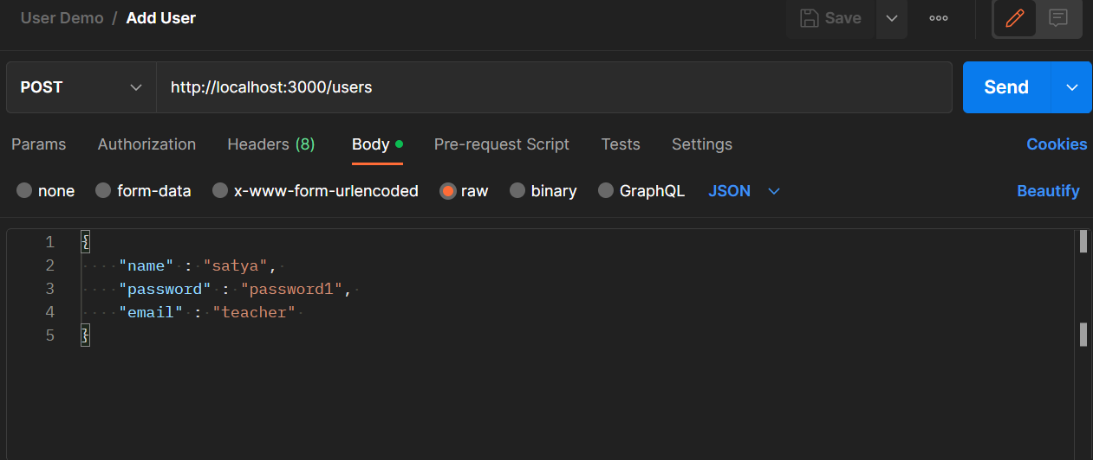
Get users

Slide 163
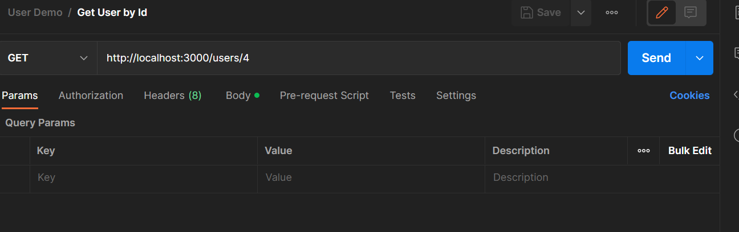
Get one user

Slide 164
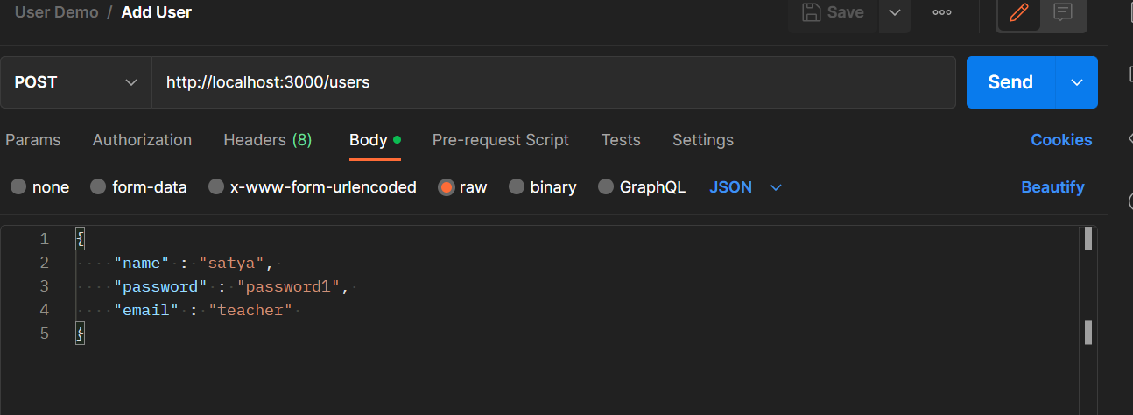
Add user

Slide 165
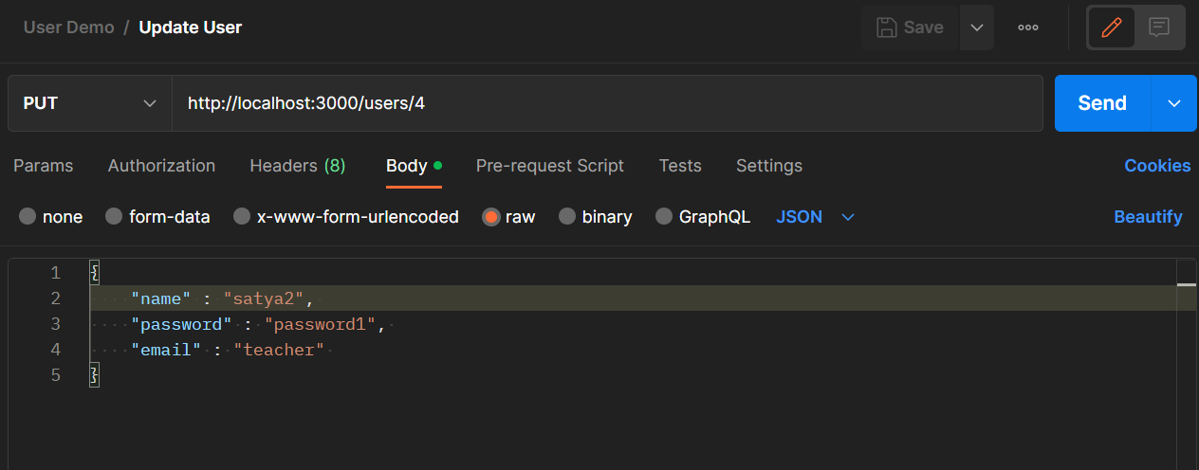
Update user

Slide 166
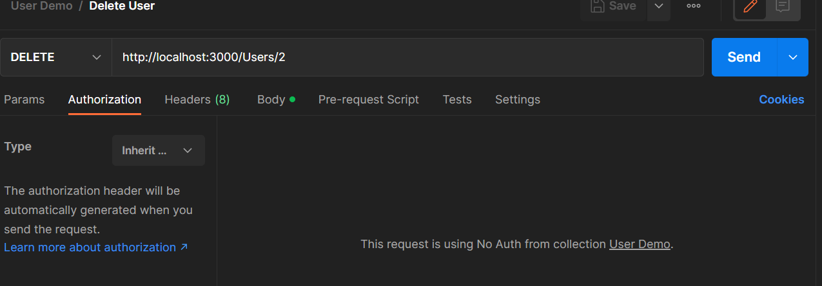
Delete user

Slide 167
Next Step
Add Logger middleware
This will log every request url and method used
Use req.url and req.method
Store url and method into a database table
Add authentication middleware
If header token is ‘dummy’ then request will be served, otherwise not.
Use req.headers[‘token’]
Send unauthorised if token is invalid.

Slide 168
Final Project
Create Authentication before doing any operation

